Slide 1
Spring workshop
Karthikeyan Bollu Ganesh
Michael Inden
Asmiq Academy

Slide 2
Contents
Introduction
Spring Framework I
Spring Architecture
Dependency Injection
DI/IoC in Spring
XML Configuration
Java Configuration
Bean Lifecycle
Bean Scopes
Exercises
Spring Framework II
Web-MVC
Exercises
Spring Boot I
Introduction
Spring Initializr
REST Service with Spring-Boot
Spring Dev-tools Demo
Testing
Exercises
Annotation Configuration

Slide 3
Introduction

Slide 4

Father of Spring

Slide 5
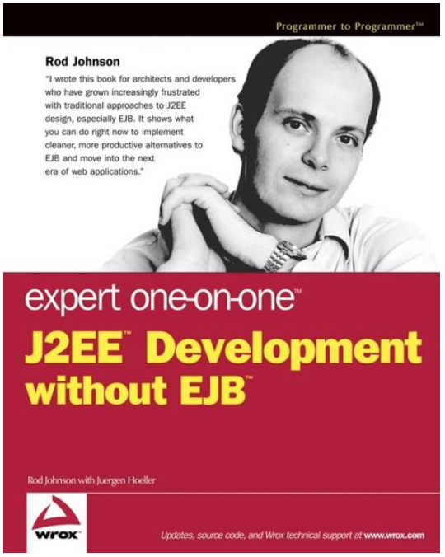
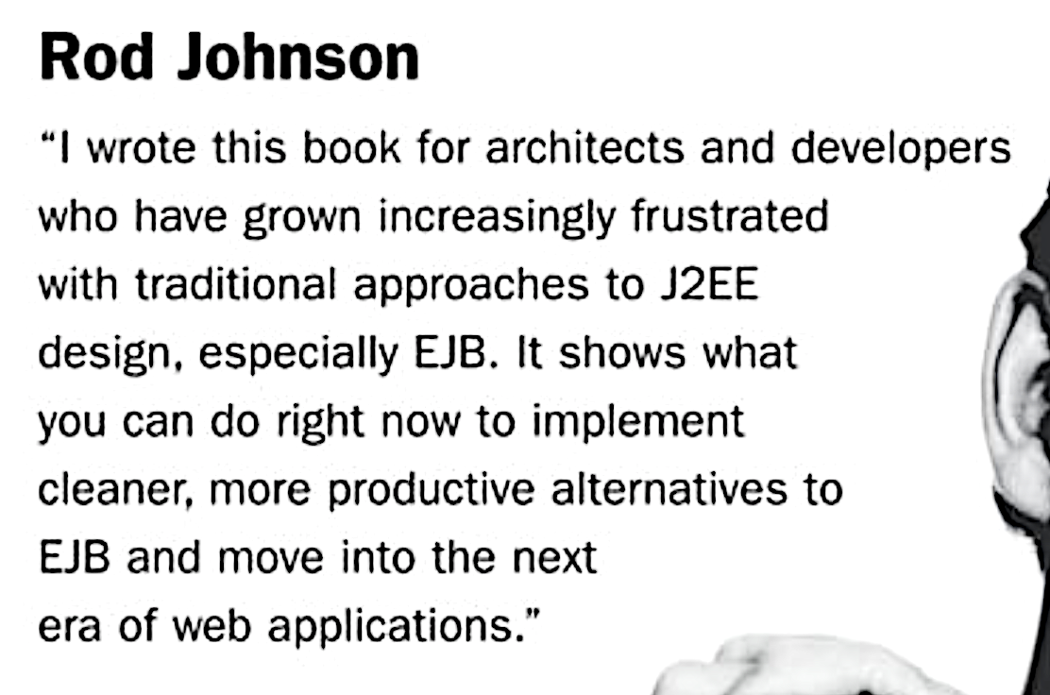
Spring‘s birth

Slide 6




Spring‘s birth
V 0.9
Notes:
Rod Johnson wrote this book on 2002 with describes the complexities of the EJB and he wrote all the infrastructure code for the dependency injection in the package com.interface21. Later Jürgen Höller requested him to create a open source framework based on this infrastructure code, which gave birth to the Spring framework.

Slide 7




Spring‘s growth
4.0
5.0
2.0
3.0
1.0
Version
2003
2006
2009
2013
2017
Year

Slide 8




Spring company‘s growth
2002
2008
2009
2013
Year
Notes:
In April 2013 VMware, and its parent company EMC Corporation, formally created a joint venture (with GE) called Pivotal Software.

Slide 9
Spring - Benefits
Light weight
Just POJO – need not implement/extend any framework interfaces/classes
Modular
Include just the needed module to use the needed functionality.
For DI just include spring-context
Non-intrusive
domain logic code generally has no dependencies on the framework itself
Notes:
Light weight/ Non-intrusive: POJO means Plain Old Java Object. It refers to a Java object (instance of definition) that isn't bogged down by framework extensions. -> https://spring.io/understanding/POJO
Modular: We do not all of the spring‘s modules to create an app. Forexample to use the DI functionality in our web-app, we can just add the spring-context module.

Slide 10





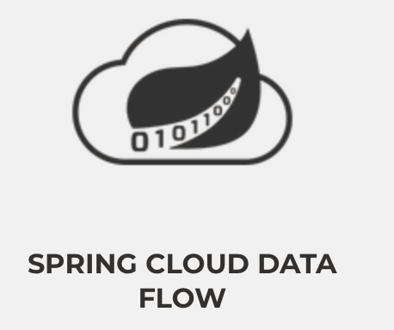


Major Spring Projects

Slide 11


Spring Framework - JDK Baseline
Version | JDK 6 | JDK 7 | JDK 8 | JDK 9 | JDK 10 | JDK 11 | JDK 12
4.3.x
5.0.x
5.1.x

Slide 12
Spring Framework 5 + JDK 9 Module
Does Spring Framework 5 work with the new Java 9 module system?
Yes, Spring Framework 5 ships with automatic module name entries in the manifests of our Spring Framework 5 jars. The public API surface of the Spring libraries remains unchanged.

Slide 13
Spring Framework I

Slide 14
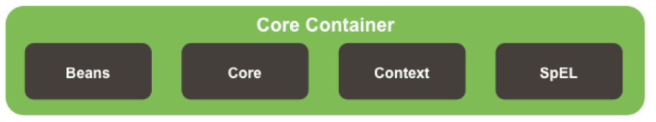
Spring Architecture

Slide 15
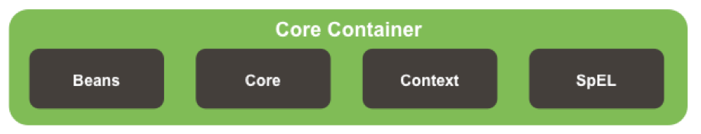



Spring Core Container Details

Slide 16
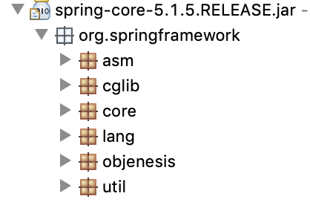
Core Module
Notes:
ASM – bytecode Manipulation and Analysis Framework
Cglib – bytecode generation library
Core – contains classes for exception-handling and for detecting the versions etc.
Lang – classes to mark the version info
Util – classes for logging configs, string manipulations etc.

Slide 17
Beans Module
Contains necessary classes and interfaces for the manipulation of the java beans
Defines most important interface like BeanFactory for Dependency Injection.
Includes utility functions for checking property types, copying bean properties, instantiating java beans.

Slide 18
Context and SpEL Modules
Context
Defines the interface ApplicationContext, which extends BeanFactory
Spring Expression Language
“Language to query and manipulate the object graph at runtime.“
#{object.property}
#{object.subobject.property}

Slide 19
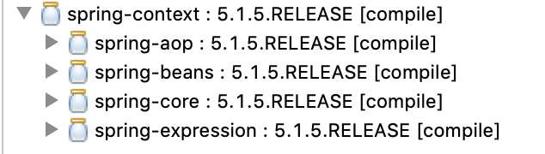
Core Container Module

Slide 20
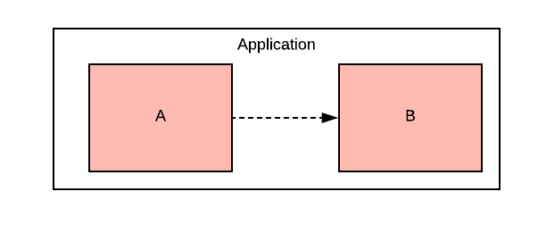
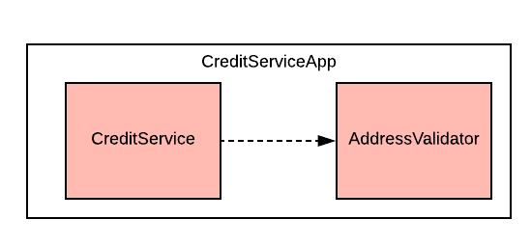
Dependency
Notes:
To provide the creditservice functionality the app depends on the validation of the address.
In crude form:
When an object A needs/uses another object B to provide a functionality of an application, then Object A is dependent on Object B

Slide 21
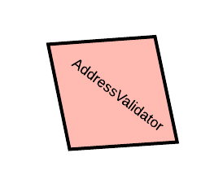
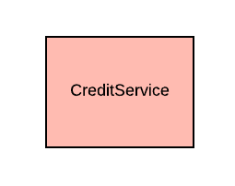


Slide 22
Dependency Injection
The process of introducing the dependency to the dependent object is called dependency injection

Slide 23
Dependency Injection
public class CreditServiceApp {
public static void main(String[] args) {
var addressValidator = new AddressValidator();
var creditService = new CreditService(addressValidator);
creditService.dispatchCredit();
}
}

Slide 24

Manual Dependency Injection
public class CreditServiceApp {
public static void main(String[] args) {
var addressValidator = new AddressValidator();
var creditService = new CreditService(addressValidator);
creditService.dispatchCredit();
}
}
Manual DI

Slide 25

What if ?
CreditService -> SmsService -> MobileSubscriptionService - > PaymentService
CreditService -> PaymentService -> InvoiceService -> InvoiceSchedulingService
MobileSubscriptionService -> GatewayService -> InvoiceService -> AddressService

Slide 26
Manual DI Problems
A depender knows the internal details of the dependee
Not easily testable
Tight Coupling
Hinders the code readability
Notes:
The more the dependencies, the more the modifications in code
A depender knows the internal details of the dependee
Example - SmsService -> MobileSubscriptionService
In this case -> SmsService has to know how to create MobileSubscriptionService
Not easily testable
Without resolving all the dependencies it is almost impossible to test the NotificationService.
Tight Coupling
Changes in the construction logic of the dependee results in the changes in the construction of the depender.
Hinders the code readability
The instantiation logic are scattered, which prevents the smooth flow of understanding the actual functionality

Slide 27

Solution for manual DI Problems
having an agent/factory/framework/x
to instantiate the dependee objects
resolve the dependencies

Slide 28
IoC / DI
The process
of letting out our control in the instantiation of dependent objects and configuring the object graph is Inversion of Control (IoC)
of resolving the dependencies is called Dependency Injection (DI)

Slide 29

Dependency Injection in Spring

Slide 30



Spring Bean
Plain Old Java Object (POJO) which is/will be managed by the Spring is called Spring Bean.
SimpleCar Bean
Spring
SimpleCar

Slide 31
IoC Container
Is also an object
manages other objects
enables Dependecy Injection
builds Object Graphs

Slide 32
IoC Container
D
C
Spring
A
B

Slide 33
IoC configuration metadata
The information needed to configure the IoC Container is Configuration Metadata

Slide 34
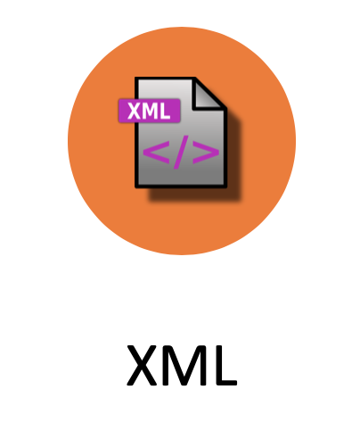

Configuration metadata types
XML
Annotation
Java

Slide 35
XML Configuration
<?xml version="1.0" encoding="UTF-8"?>
<beans xmlns="http://www.springframework.org/schema/beans"
xmlns:xsi="http://www.w3.org/2001/XMLSchema-instance"
xsi:schemaLocation="http://www.springframework.org/schema/beans http://www.springframework.org/schema/beans/spring-beans.xsd">
<bean id="<bean_id>" class="<class>">
<property name=""></property>
<property name=""></property>
</bean>
</beans>

Slide 36
Java Configuration
@Configuration
public class MyConfig{
@Bean
public A a(){
//return A
}
@Bean
public B b(){
// return B
}
}

Slide 37
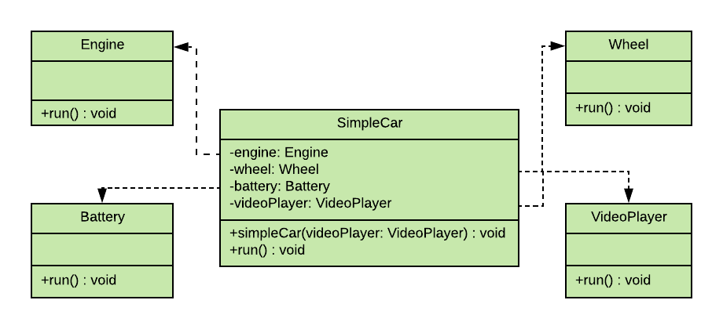
XML Configuration

Slide 38
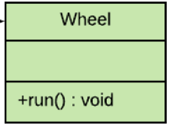
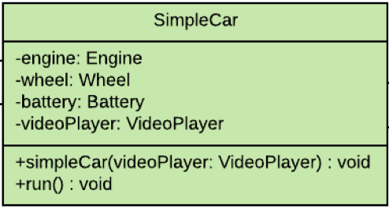
<?xml version="1.0" encoding="UTF-8"?>
<beans xmlns="http://www.springframework.org/schema/beans"
xmlns:xsi="http://www.w3.org/2001/XMLSchema-instance"
xsi:schemaLocation="http://www.springframework.org/schema/beans http://www.springframework.org/schema/beans/spring-beans.xsd">
<bean id="wheel" class="ch.karthi.Wheel"/>
<bean id="engine" class="ch.karthi.Engine"/>
<bean id="battery" class="ch.karthi.Battery"/>
<bean id="videoPlayer" class="ch.karthi.VideoPlayer"/>
<bean id="simpleCar" class="ch.karthi.SimpleCar">
<constructor-arg ref="videoPlayer" name="videoPlayer"/>
<property name="engine" ref="engine" />
<property name="wheel" ref="wheel"/>
<property name="battery" ref="battery"/>
</bean>
</beans>

Slide 39
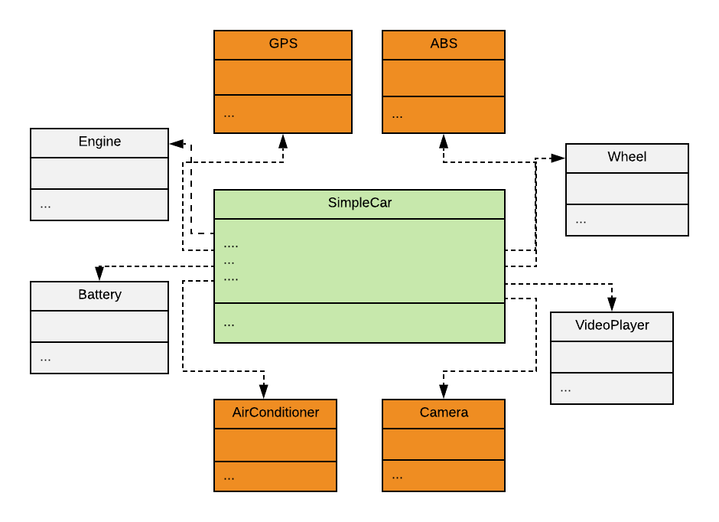
XML Configuration

Slide 40
<?xml version="1.0" encoding="UTF-8"?>
<beans xmlns="http://www.springframework.org/schema/beans"
xmlns:xsi="http://www.w3.org/2001/XMLSchema-instance"
xsi:schemaLocation="http://www.springframework.org/schema/beans http://www.springframework.org/schema/beans/spring-beans.xsd">
<bean id="wheel" class="ch.karthi.Wheel"/>
<bean id="engine" class="ch.karthi.Engine"/>
<bean id="battery" class="ch.karthi.Battery"/>
<bean id="videoPlayer" class="ch.karthi.VideoPlayer"/>
<bean id="gps" class="ch.karthi.GPS"/>
<bean id="camera" class="ch.karthi.Camera"/>
<bean id= … />
...
<bean id="simpleCar" class="ch.karthi.SimpleCar">
<constructor-arg ref="videoPlayer" name="videoPlayer"/>
<property name="engine" ref="engine" />
<property name="wheel" ref="wheel"/>
<property name="battery" ref="battery"/>
</bean>
</beans>

Slide 41
<?xml version="1.0" encoding="UTF-8"?>
<beans xmlns="http://www.springframework.org/schema/beans"
xmlns:xsi="http://www.w3.org/2001/XMLSchema-instance"
xsi:schemaLocation="http://www.springframework.org/schema/beans http://www.springframework.org/schema/beans/spring-beans.xsd">
Karthi : Hey Spring! Could you please do the bean definitions for me ?
Spring : Yes with pleasure. For that I need some infos too.
<bean id="simpleCar" class="ch.karthi.SimpleCar">
<constructor-arg ref="videoPlayer" name="videoPlayer"/>
<property name="engine" ref="engine" />
<property name="wheel" ref="wheel"/>
<property name="battery" ref="battery"/>
</bean>
</beans>

Slide 42
<?xml version="1.0" encoding="UTF-8"?>
<beans xmlns="http://www.springframework.org/schema/beans"
xmlns:xsi="http://www.w3.org/2001/XMLSchema-instance"
xsi:schemaLocation=http://www.springframework.org/schema/beans http://www.springframework.org/schema/beans/spring-beans.xsd
http://www.springframework.org/schema/context http://www.springframework.org/schema/context/spring-context.xsd">
<bean id="simpleCar" class="ch.karthi.SimpleCar">
<constructor-arg ref="videoPlayer" name="videoPlayer"/>
<property name="engine" ref="engine" />
<property name="wheel" ref="wheel"/>
<property name="battery" ref="battery"/>
</bean>
</beans>

Slide 43

Annotation configuration
@Component
public class Wheel {
Stereotype Annotations
@Component
public class SimpleCar {
@Component
public class Engine {
@Component
public class VideoPlayer {
@Component
public class Battery {

Slide 44
Stereotype Annotations
@Component
@Service
@Repository
@Controller
@RestController
@ControllerAdvice
@Configuration

Slide 45
<?xml version="1.0" encoding="UTF-8"?>
<beans xmlns="http://www.springframework.org/schema/beans"
xmlns:xsi="http://www.w3.org/2001/XMLSchema-instance"
xsi:schemaLocation=http://www.springframework.org/schema/beans http://www.springframework.org/schema/beans/spring-beans.xsd
http://www.springframework.org/schema/context http://www.springframework.org/schema/context/spring-context.xsd">
Karthi : Hey Spring! is it possible to configure these dependencies in java class itself?
Spring : Yes with pleasure. see @Autowired
<bean id="simpleCar" class="ch.karthi.SimpleCar">
<constructor-arg ref="videoPlayer" name="videoPlayer"/>
<property name="engine" ref="engine" />
<property name="wheel" ref="wheel"/>
<property name="battery" ref="battery"/>
</bean>
</beans>

Slide 46
@Autowired
@Component
public class SimpleCar {
@Autowired
private Engine engine;
@Autowired
private Wheel wheel;
@Autowired
private VideoPlayer videoPlayer;
@Autowired
private Battery battery;
@Autowired
public SimpleCar(VideoPlayer videoPlayer) {
this.videoPlayer = videoPlayer;
}

Slide 47
<?xml version="1.0" encoding="UTF-8"?>
<beans xmlns="http://www.springframework.org/schema/beans"
xmlns:xsi="http://www.w3.org/2001/XMLSchema-instance"
xsi:schemaLocation=http://www.springframework.org/schema/beans http://www.springframework.org/schema/beans/spring-beans.xsd
http://www.springframework.org/schema/context http://www.springframework.org/schema/context/spring-context.xsd">
Karthi : Hey Spring! is it possible to configure this in java class itself?
Spring : Yes with pleasure. Use @ComponentScan and remove this XML File ☺
</beans>

Slide 48
Java Configuration
@ComponentScan("ch.karthi")
public class AppConfig {…}
<bean id="wheel" class="ch.karthi.Wheel"></bean>
<bean id="engine" class="ch.karthi.Engine"></bean>
<bean id="battery" class="ch.karthi.Battery"></bean>
<bean id="videoPlayer" class="ch.karthi.VideoPlayer"></bean>
<bean id="simpleCar" class="ch.karthi.SimpleCar">
<constructor-arg ref="videoPlayer" name="videoPlayer"></constructor-arg>
<property name="engine" ref="engine"></property>
<property name="wheel" ref="wheel"></property>
<property name="battery" ref="battery"></property>
</bean>
@Component
public class Engine {
@Component
public class SimpleCar {
@Autowired
private Engine engine;

Slide 49
@Configuration
public class AppConfig {
@Bean
public Battery battery() {
return new Battery();
}
//further bean definitions
@Bean
public SimpleCar simpleCar() {
SimpleCar simpleCar = new SimpleCar(videoPlayer());
simpleCar.setBattery(battery());
// set other properties
return simpleCar;
}
}
@Configuration
public class AppConfig {
@Bean
public Battery battery() {
return new Battery();
}
//further bean definitions
@Bean
public SimpleCar simpleCar(Battery battery, Engine engine, Wheel wheel, VideoPlayer videoPlayer){
SimpleCar simpleCar = new SimpleCar(videoPlayer);
simpleCar.setBattery(battery);
// set other properties
return simpleCar;
}
}

Slide 50

IoC Container instantiation & usage

Slide 51
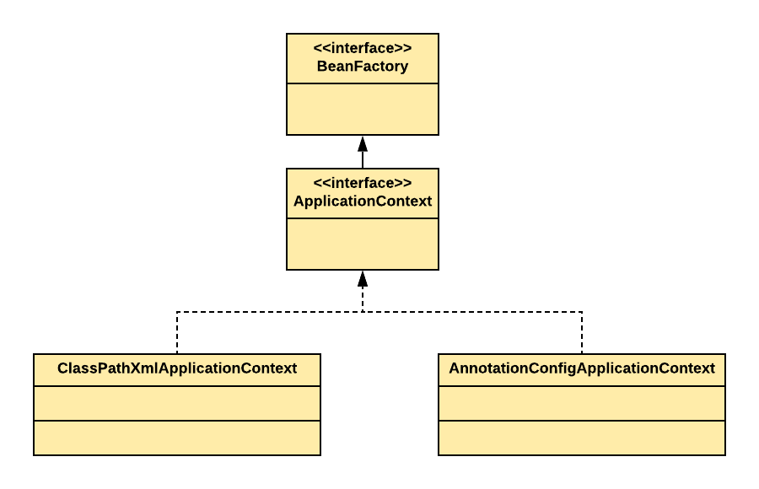
IoC Container in Spring

Slide 52
XML
var context = new ClassPathXmlApplicationContext("config.xml");
var simpleCar = context.getBean(SimpleCar.class);
// start the simpleCar

Slide 53
Annotation
var context = new ClassPathXmlApplicationContext("config.xml");
var simpleCar = context.getBean(SimpleCar.class);
// start the simpleCar

Slide 54

Java
@ComponentScan("ch.karthi")
public class AppConfig {…}
var context = new AnnotationConfigApplicationContext(AppConfig.class);
var simpleCar = context.getBean(SimpleCar.class);
// start the simpleCar
@Configuration
public class AppConfig {…}

Slide 55



Dependency Injection Types

Slide 56
Constructor Injection
public SimpleCar(VideoPlayer videoPlayer){
this.videoPlayer = videoPlayer;
}

Slide 57
Constructor Injection
Rule: @Autowired should be present atleast on one constructor, when more than one constructor has been declared.
public SimpleCar() {}
@Autowired
public SimpleCar(VideoPlayer videoPlayer) {
this.videoPlayer = videoPlayer;
}
Exception in thread "main" java.lang.NullPointerException

Slide 58


Constructor Injection
@Autowired
public MyBean(A a) {
@Autowired
public MyBean(A a, B b, …) {
@Autowired
public MyBean(A a, @Autowired(required=false) B b, …) {
Spring
A
Caused by: org.springframework.beans.factory.NoSuchBeanDefinitionException: No qualifying bean of type 'ch.karthi.B' available: expected at least 1 bean which qualifies as autowire candidate. Dependency annotations: {}

Slide 59
Setter Injection
public class SimpleCar {
@Autowired
private Engine engine;
@Autowired
private Wheel wheel;
@Autowired
public void setEngine(Engine engine) {
this.engine = engine;
}
@Autowired
public void setWheel(Wheel wheel) {
this.wheel = wheel;
}
}
Field Injection

Slide 60
Constructor or Setter Injection ?
Use constructor for mandatory fields
Use setter for optional fields

Slide 61
DI Modes
byName
byType
by qualifier

Slide 62
@Primary

Slide 63
LazyInitialisation

Slide 64
DI of scalar values

Slide 65
Bean Lifecycle Callbacks
Initialization callbacks
Destruction callbacks
Notes:
1. Initialisation Callbacks – After the bean‘s constructor has been called by Spring and we still want to do some other kind of initialisation like initialising the filestream, open up a db connection, initialising the AWS connection etc, which are not part of the bean construction but we still want to make sure these initialisation before the bean is put into use.

Slide 66
Initialization callbacks
InitializingBean
initMethod in @Bean
@PostConstruct

Slide 67
@PostConstruct
@Component
public class VideoPlayer {
private AsmiqAcademyStream asmiqAcademyStream;
private YoutubeStream youtubeStream;
private String youtubeApiKey = "y7k8nd9d92dl2m";
private String asmiqAcademyApiKey = "y7k8nd9d92dl2m";
@PostConstruct
private void initStreams() {
asmiqAcademyStream = AsmiqAcademyStream.builder().withApiKey(asmiqAcademyApiKey).build();
youtubeStream = YoutubeStream.builder().withApiKey(youtubeApiKey).build();
}
public void run() {
// start any of the stream
}
}

Slide 68
InitializingBean
Component
public class VideoPlayer implements InitializingBean{
private AsmiqAcademyStream asmiqAcademyStream;
private YoutubeStream youtubeStream;
private String youtubeApiKey = "y7k8nd9d92dl2m";
private String asmiqAcademyApiKey = "y7k8nd9d92dl2m";
@Override
public void afterPropertiesSet() throws Exception {
asmiqAcademyStream = AsmiqAcademyStream.builder().withApiKey(asmiqAcademyApiKey).build();
youtubeStream = YoutubeStream.builder().withApiKey(youtubeApiKey).build();
}
public void run() {
// start any of the stream
}
}

Slide 69
initMethod in @Bean
@Configuration
public class AppConfig {
@Bean(initMethod="initStreams")
public VideoPlayer videoPlayer() {
return new VideoPlayer();
}
}
@Component
public class VideoPlayer {
private void initStreams() {
// init the streams
}
public void run() {
// start any of the stream
}
}

Slide 70

Initialization callbacks precedence
PostConstruct
InitializingBean
initMethod in @Bean

Slide 71
Destruction callbacks
DisposableBean
destroyMethod in @Bean
@Predestroy

Slide 72
@Predestroy
@Component
public class VideoPlayer {
private AsmiqAcademyStream asmiqAcademyStream;
private YoutubeStream youtubeStream;
private String youtubeApiKey = "y7k8nd9d92dl2m";
private String asmiqAcademyApiKey = "y7k8nd9d92dl2m";
@PreDestroy
private void signOffStreams() {
asmiqAcademyStream.signOff();
youtubeStream.signOff();
}
public void run() {
// start any of the stream
}
}

Slide 73
DisposableBean
Component
public class VideoPlayer implements DisposableBean{
private AsmiqAcademyStream asmiqAcademyStream;
private YoutubeStream youtubeStream;
private String youtubeApiKey = "y7k8nd9d92dl2m";
private String asmiqAcademyApiKey = "y7k8nd9d92dl2m";
@Override
public void destroy(){
asmiqAcademyStream.signOff();
youtubeStream.signOff();
}
public void run() {
// start any of the stream
}
}

Slide 74
destroyMethod in @Bean
@Configuration
public class AppConfig {
@Bean(destroyMethod="signOffStreams")
public VideoPlayer videoPlayer() {
return new VideoPlayer();
}
}
@Component
public class VideoPlayer {
private void signOffStreams() {
// signoff the streams
}
public void run() {
// start any of the stream
}
}

Slide 75
Destruction callbacks precedence
PreDestroy
DisposableBean
destroyMethod in @Bean

Slide 76
Bean Scopes

